Slide 1
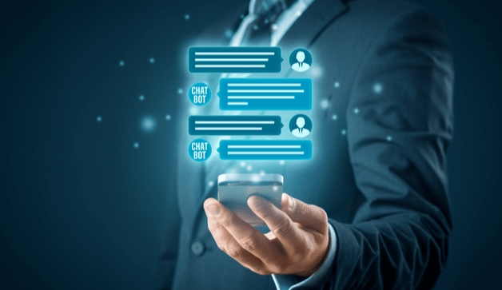

PROJECT REPORT PRESENTATION
on
CHATBOT USING PYTHON Under the guidance of (Mrs. SHILPI KHANNA) Presented By:- SHIVAM PANDEY(1712213069)
PRASHANT UPADHYAY(1712213094) Department Of Information Technology Shri Ramswaroop Memorial Group Of
Professional Colleges, Lucknow

Slide 2
Problem Definition
Artificial intelligence chatbot is a technology that makes interactions between man and machines using natural language possible. From literature, we found out that in general, chatbot are functions like a typical search engine.
Chatbot just produced only one output instead of multiple outputs/results, the basic process flow is the same where each time an input is entered, the new search will be done.
This research is focused on enabling chatbot to become a search engine that can process the next search with the relation to the previous search output.

Slide 3
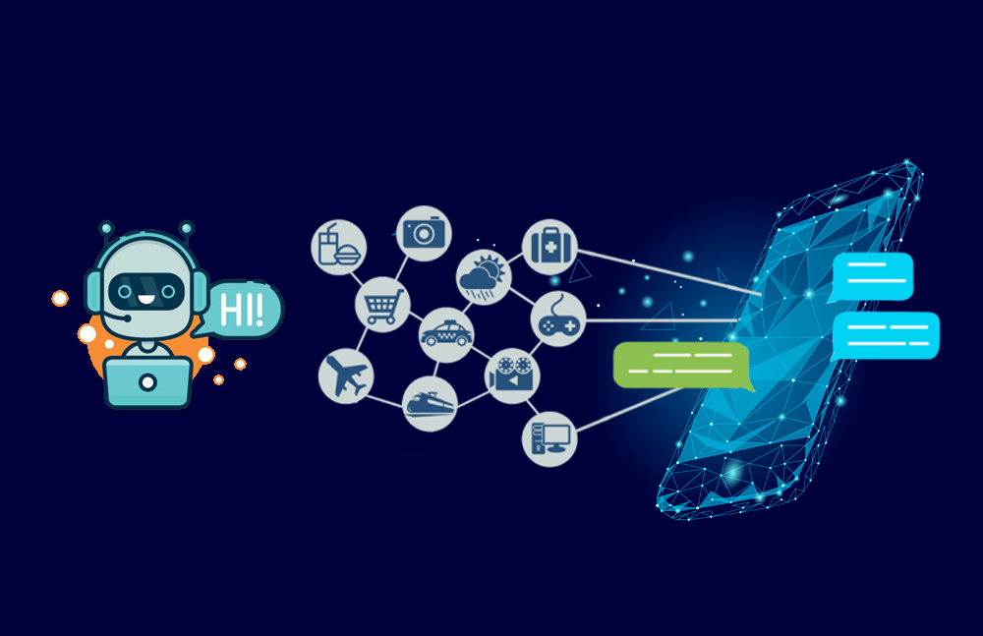
Introduction
A chatbot is an intelligent piece of software that is capable of communicating and performing actions similar to a human. Chatbots are used a lot in customer interaction, marketing on social network sites and instantly messaging the client.

Slide 4
Objectives
Chatbot applications streamline interactions between people and services, enhancing customer experience. At the same time, they offer companies new opportunities to improve the customers engagement process and operational efficiency by reducing the typical cost of customer service.
Increase operational efficiency.
Automating customer request fulfillment.
Handling basic queries,which is turn free employees to work for complex & higher value inquiries.
Improve the response rate as well as customer engagement.

Slide 5
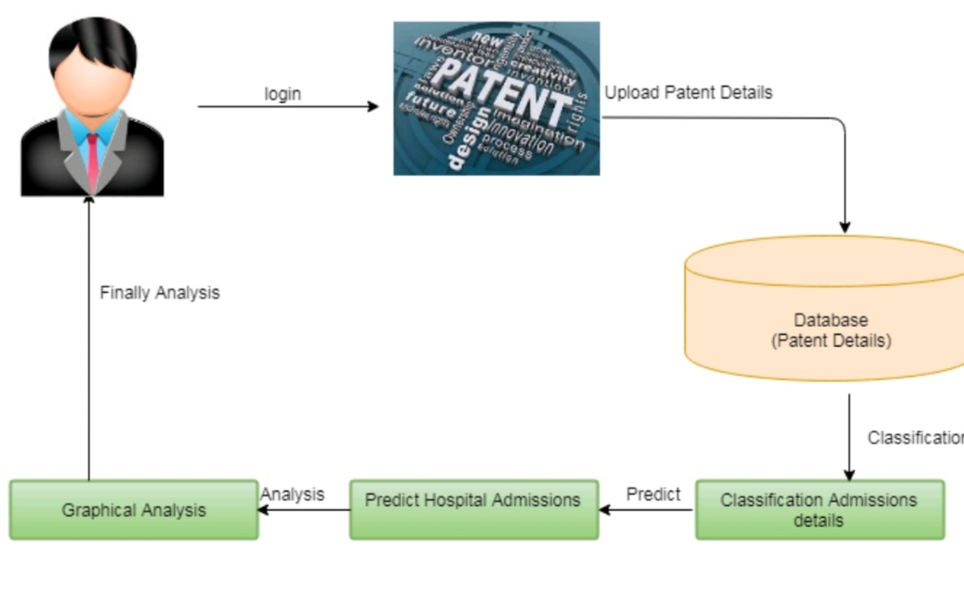
System architecture

Slide 6
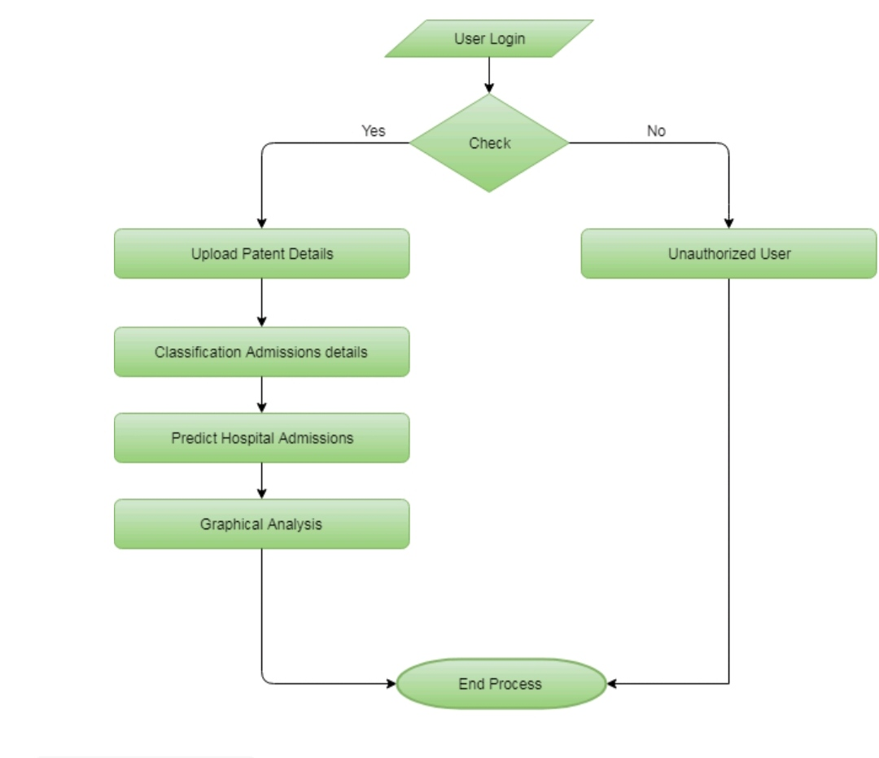
DFD( DATA FLOW DIAGRAM)

Slide 7
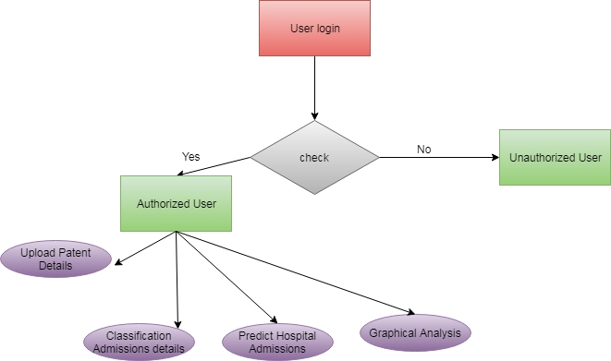
ER DIAGRAM

Slide 8
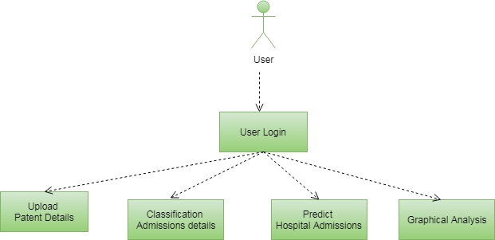
Use case diagram

Slide 9
module
Login page
Upload Patient Details
View Patient Detail
Classification Admission Details
Predict Hospital Admissions Analysis
Chatbot
Logout

Slide 10
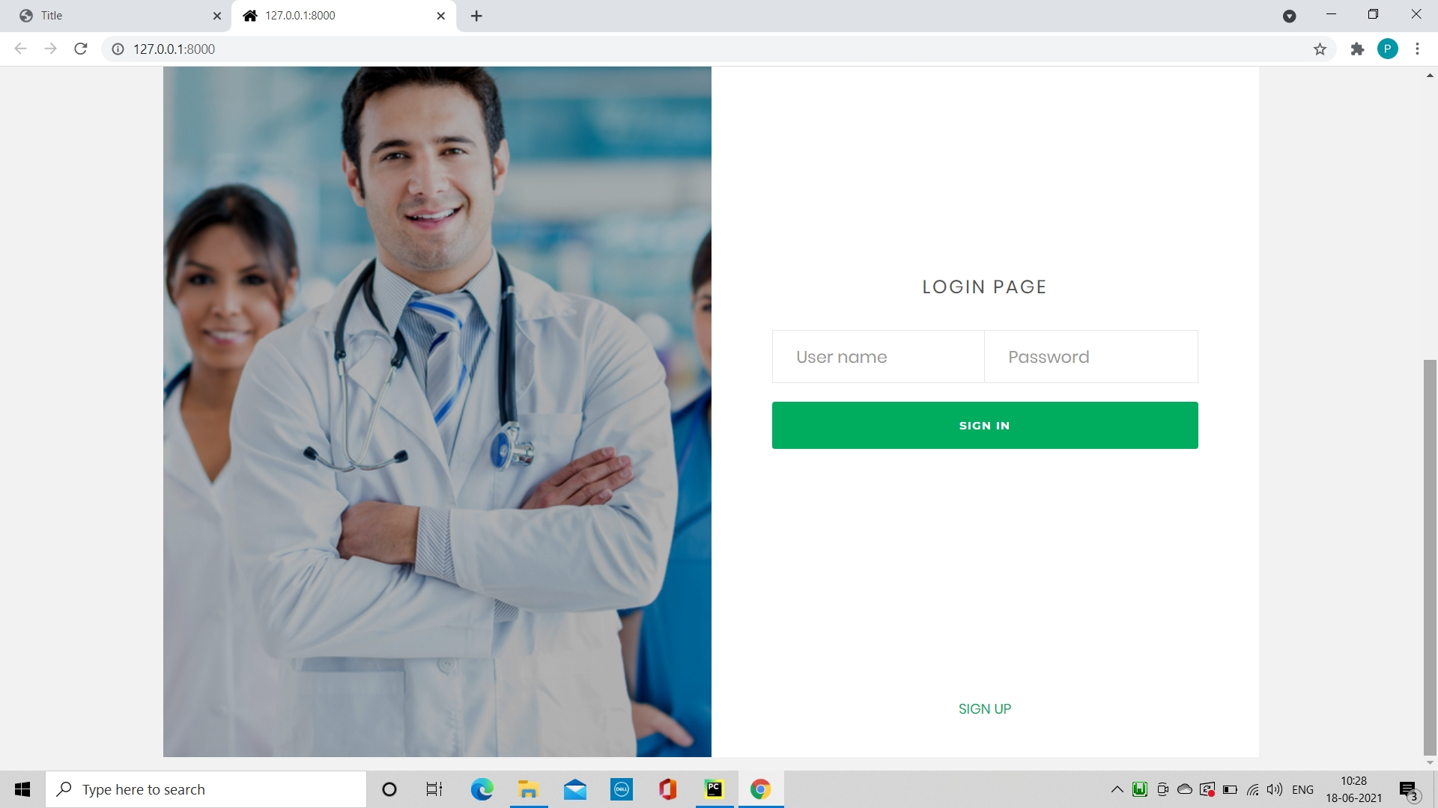
LOGIN page

Slide 11
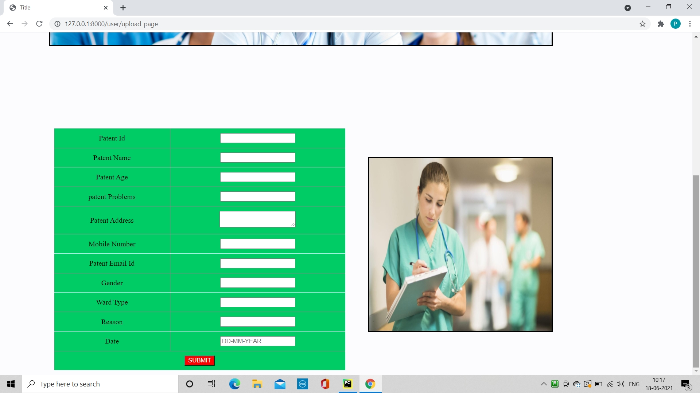
CREATING PROFILE

Slide 12
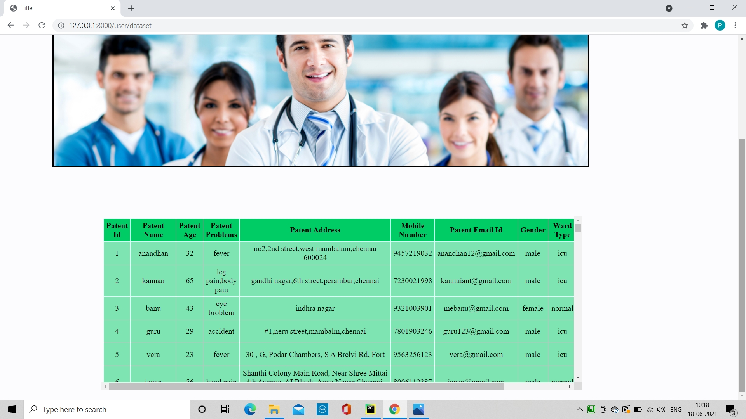
PATIENT DETAILS

Slide 13
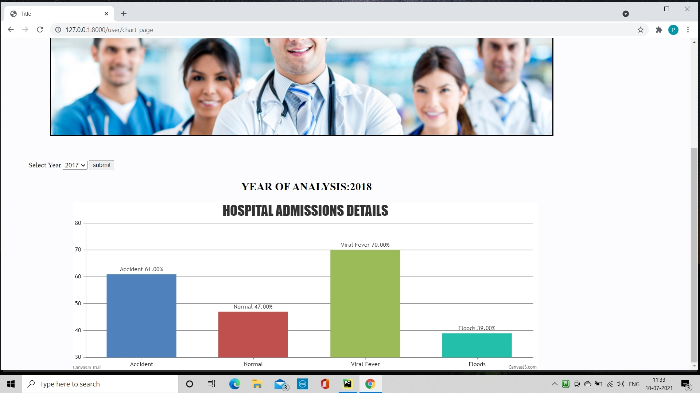
GRAPHICAL ANALYSIS

Slide 14
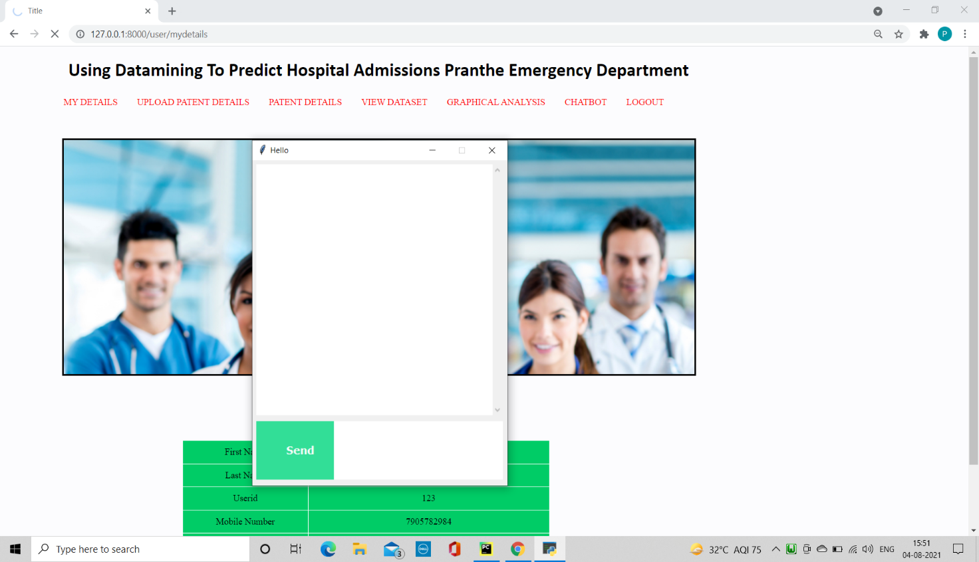
CHAT WINDOW

Slide 15
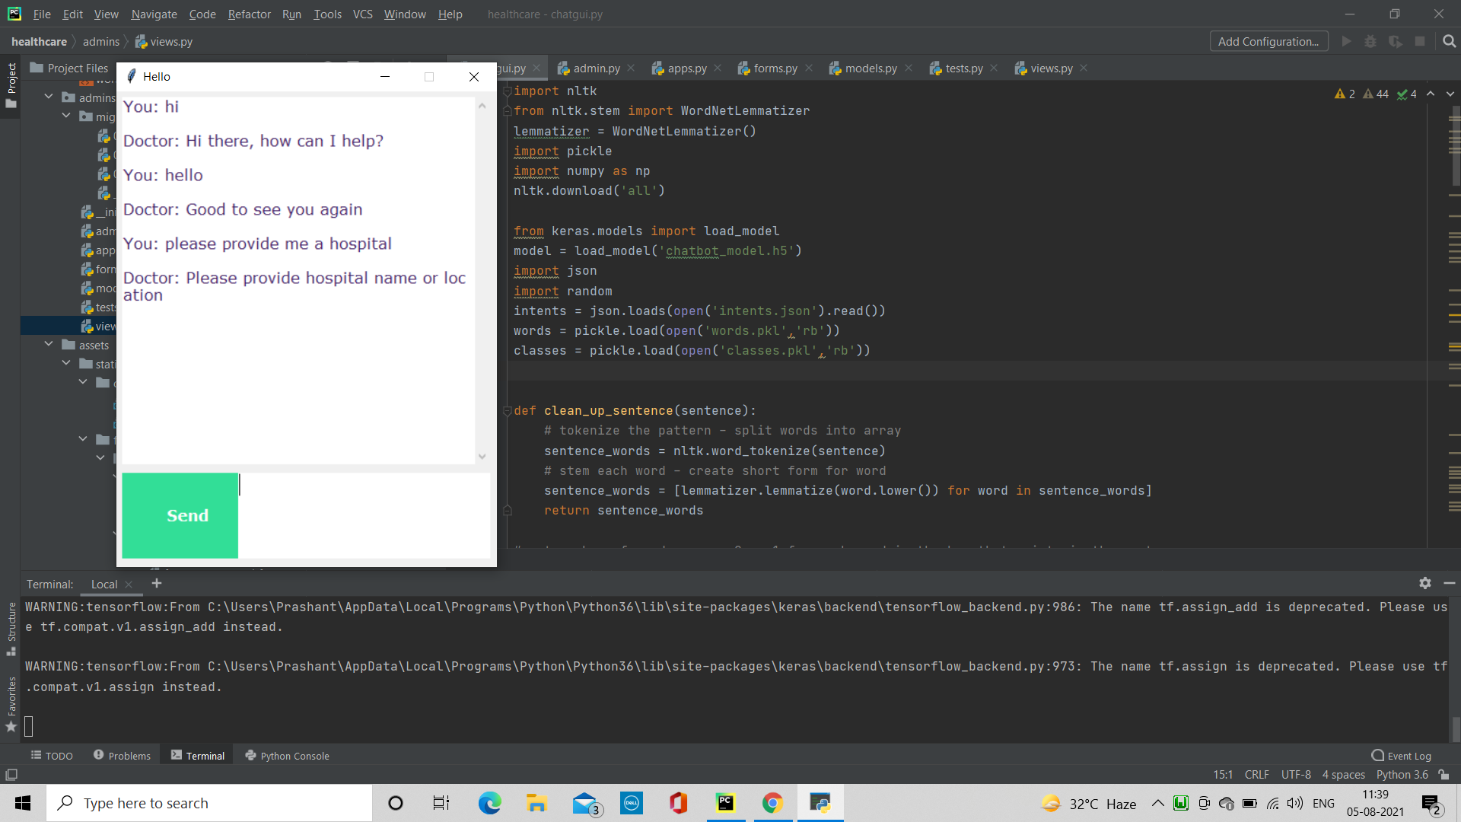
TESTINNG CHATBOT

Slide 16
SOFTWARE REQUIREMENTS
Python
Django
Mysql
Wampserver

Slide 17
Functional Requirements
Allow unregistered users to register and save the details on the database.
Provide confirmation notification through the SMS.
Users will be able to converse with the chatbot through text command.
It will understand what the user is saying through natural language understanding.

Slide 18
Non functional Requirements
The chatbot must be reliable with next to no faults or bug.
The database must be scalable to adopt to growing number of users.
The use of natural language used to interact with tha chatbot pramotes human computer interaction.
Provide accurate responses to input.

Slide 19
difficulties
Front End Design
Database design
Customization of layout

Slide 20
THANK YOU

